Slide 1
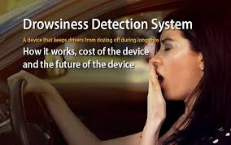

Slide 2
INTRODUCTION
We have built a system which will detect
and alarm the driver when he is feeling
sleepy and that would prevent road
accidents from happening

Slide 3
PROBLEM STATEMENT
In today’s world driving has become an essential part of our lives and even as an profession .People drive vehicles for hours and some time even days so they may tend to be drowsy and Drowsiness causes accidents all around the globe , around 40% of the road accidents are caused due to drivers feeling sleepy while driving.

Slide 4
BASIC PRINCIPLE
The basic principle is to detect drowsiness with the help of a web cam as it will analyze the eyes and when ever we close our eyes it will detect the axis of the eye to the normal axis of the eye given and if it is different it waits for a few second’s and alert the driver.

Slide 5
SOFTWARE’S USED
PYTHON IDE
ANACONDA
OPEN CV
MSG91

Slide 6
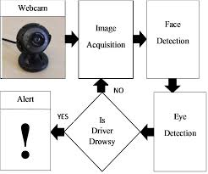
HOW DOES IT WORK

Slide 7
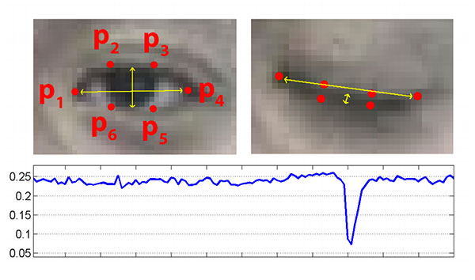

Slide 8
MERITS
1. Detects drowsiness
2. Decreasing road accidents
3. System implemented without using database storage

Slide 9
LIMITATIONS
1.Dependence on ambient light
2.Optimum range required
3.Orientation of face
4.Poor detection with spectacles
5. Hardware requirements

Slide 10
CONCLUSION
We have built a real time system for monitoring and detecting the loss of attention of the driver driving the vehicle.
In this approach the face of the driver has been detected using number of algorithm and warning is given to the driver to avoid real time crashes.

Slide 11
THANK YOU
PROJECT DEVELOPED BY :-
VAIBHAV JAISWAL
PABBA VISHNU
BRINDA VENKATARAMANA
L POOJITHA

